Slide 1
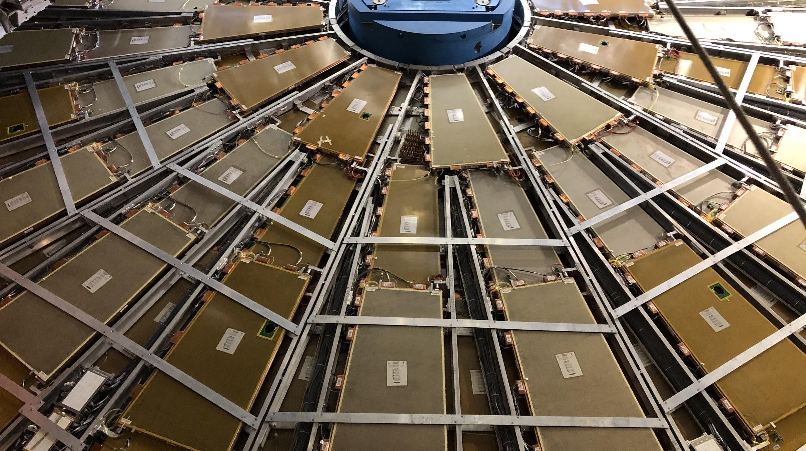

Maintenance & Consolidation Status
Hardware, Maintenance, & Operation Session, 6 October 2021
Dawit Belayneh and Katie Hughes on behalf of the Maintenance Team

Slide 2
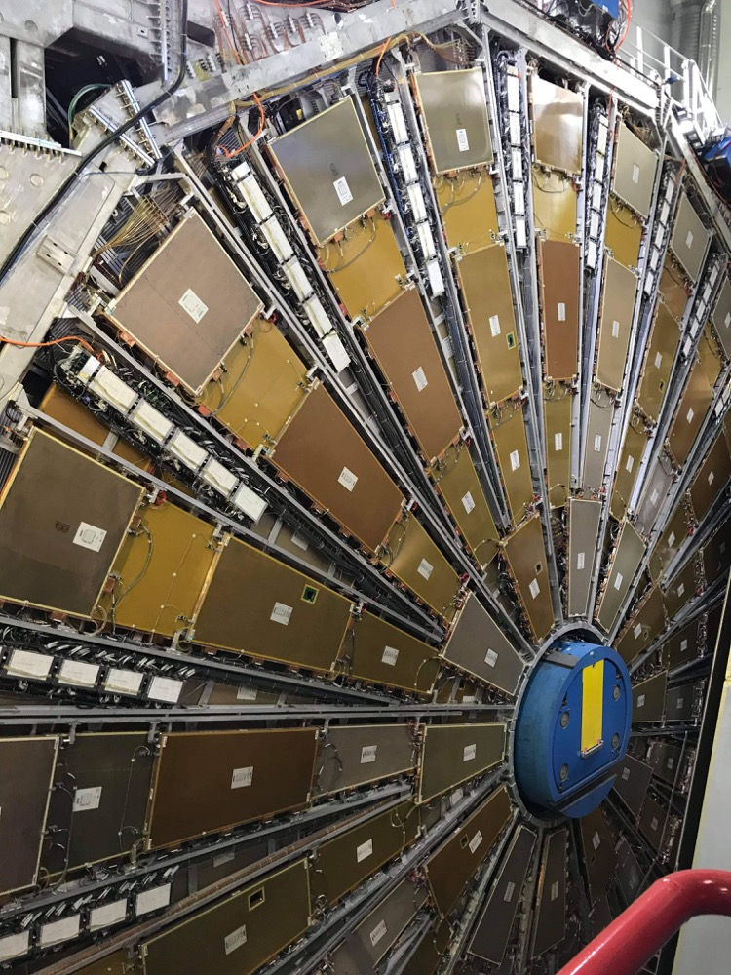
Outline
Cooling Valve Installations
Motivation
Installation Procedure
Current progress
Maintenance work

Slide 3
Cooling Valve Installations

Slide 4
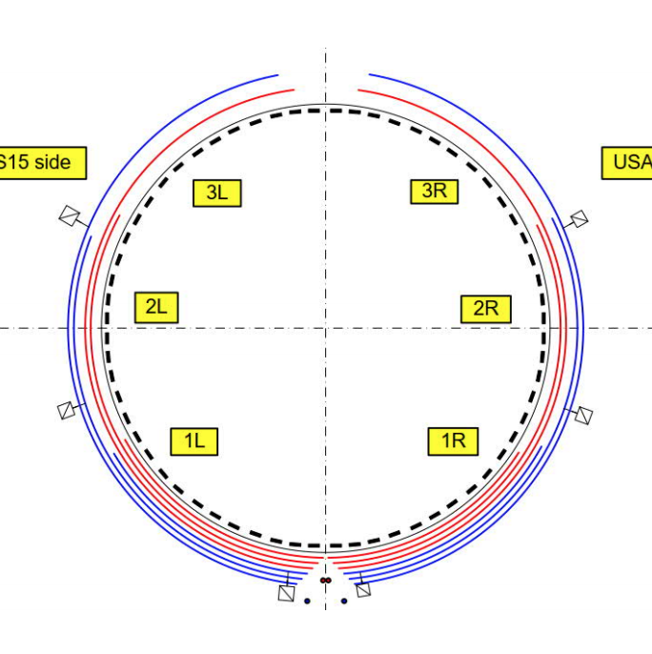
Motivation
Currently, a single cooling loop passes through 8-12 drawers
6 loops per partition
A leak in one drawer can provoke ineffective cooling for all other drawers in the loop. To fix it, all drawers in the loop must be shut down.
Valves will now isolate leaks to a single drawer
Cooling Loop Distribution

Slide 5
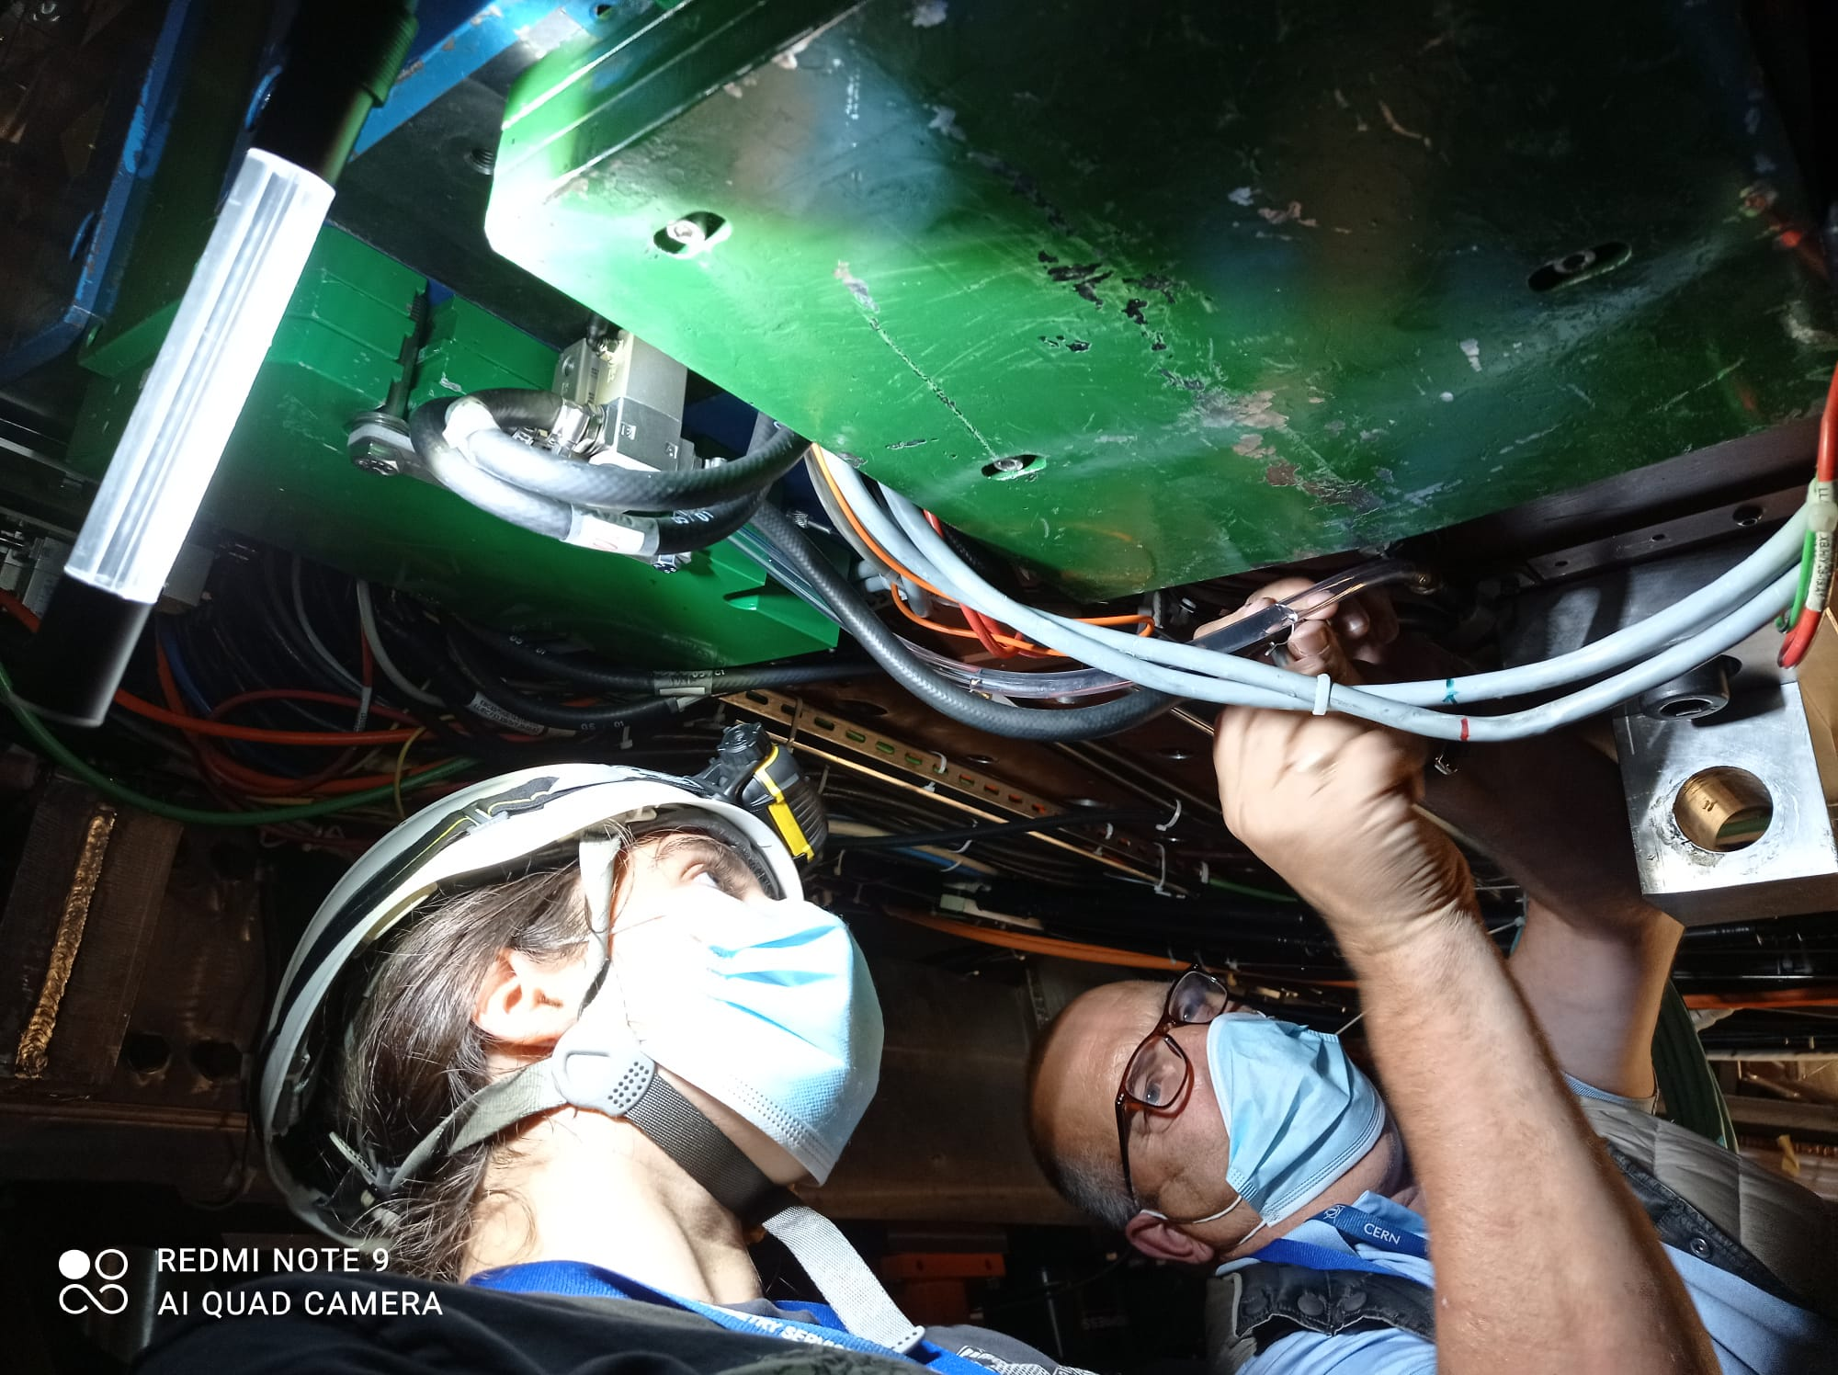
Installation Procedure
Build and test valves
Identify drawers and appropriate cooling loop
Mount brackets with valves on accessible drawers
Stop cooling loops, connect hoses to valves, restart loops and check for leaks

Slide 6
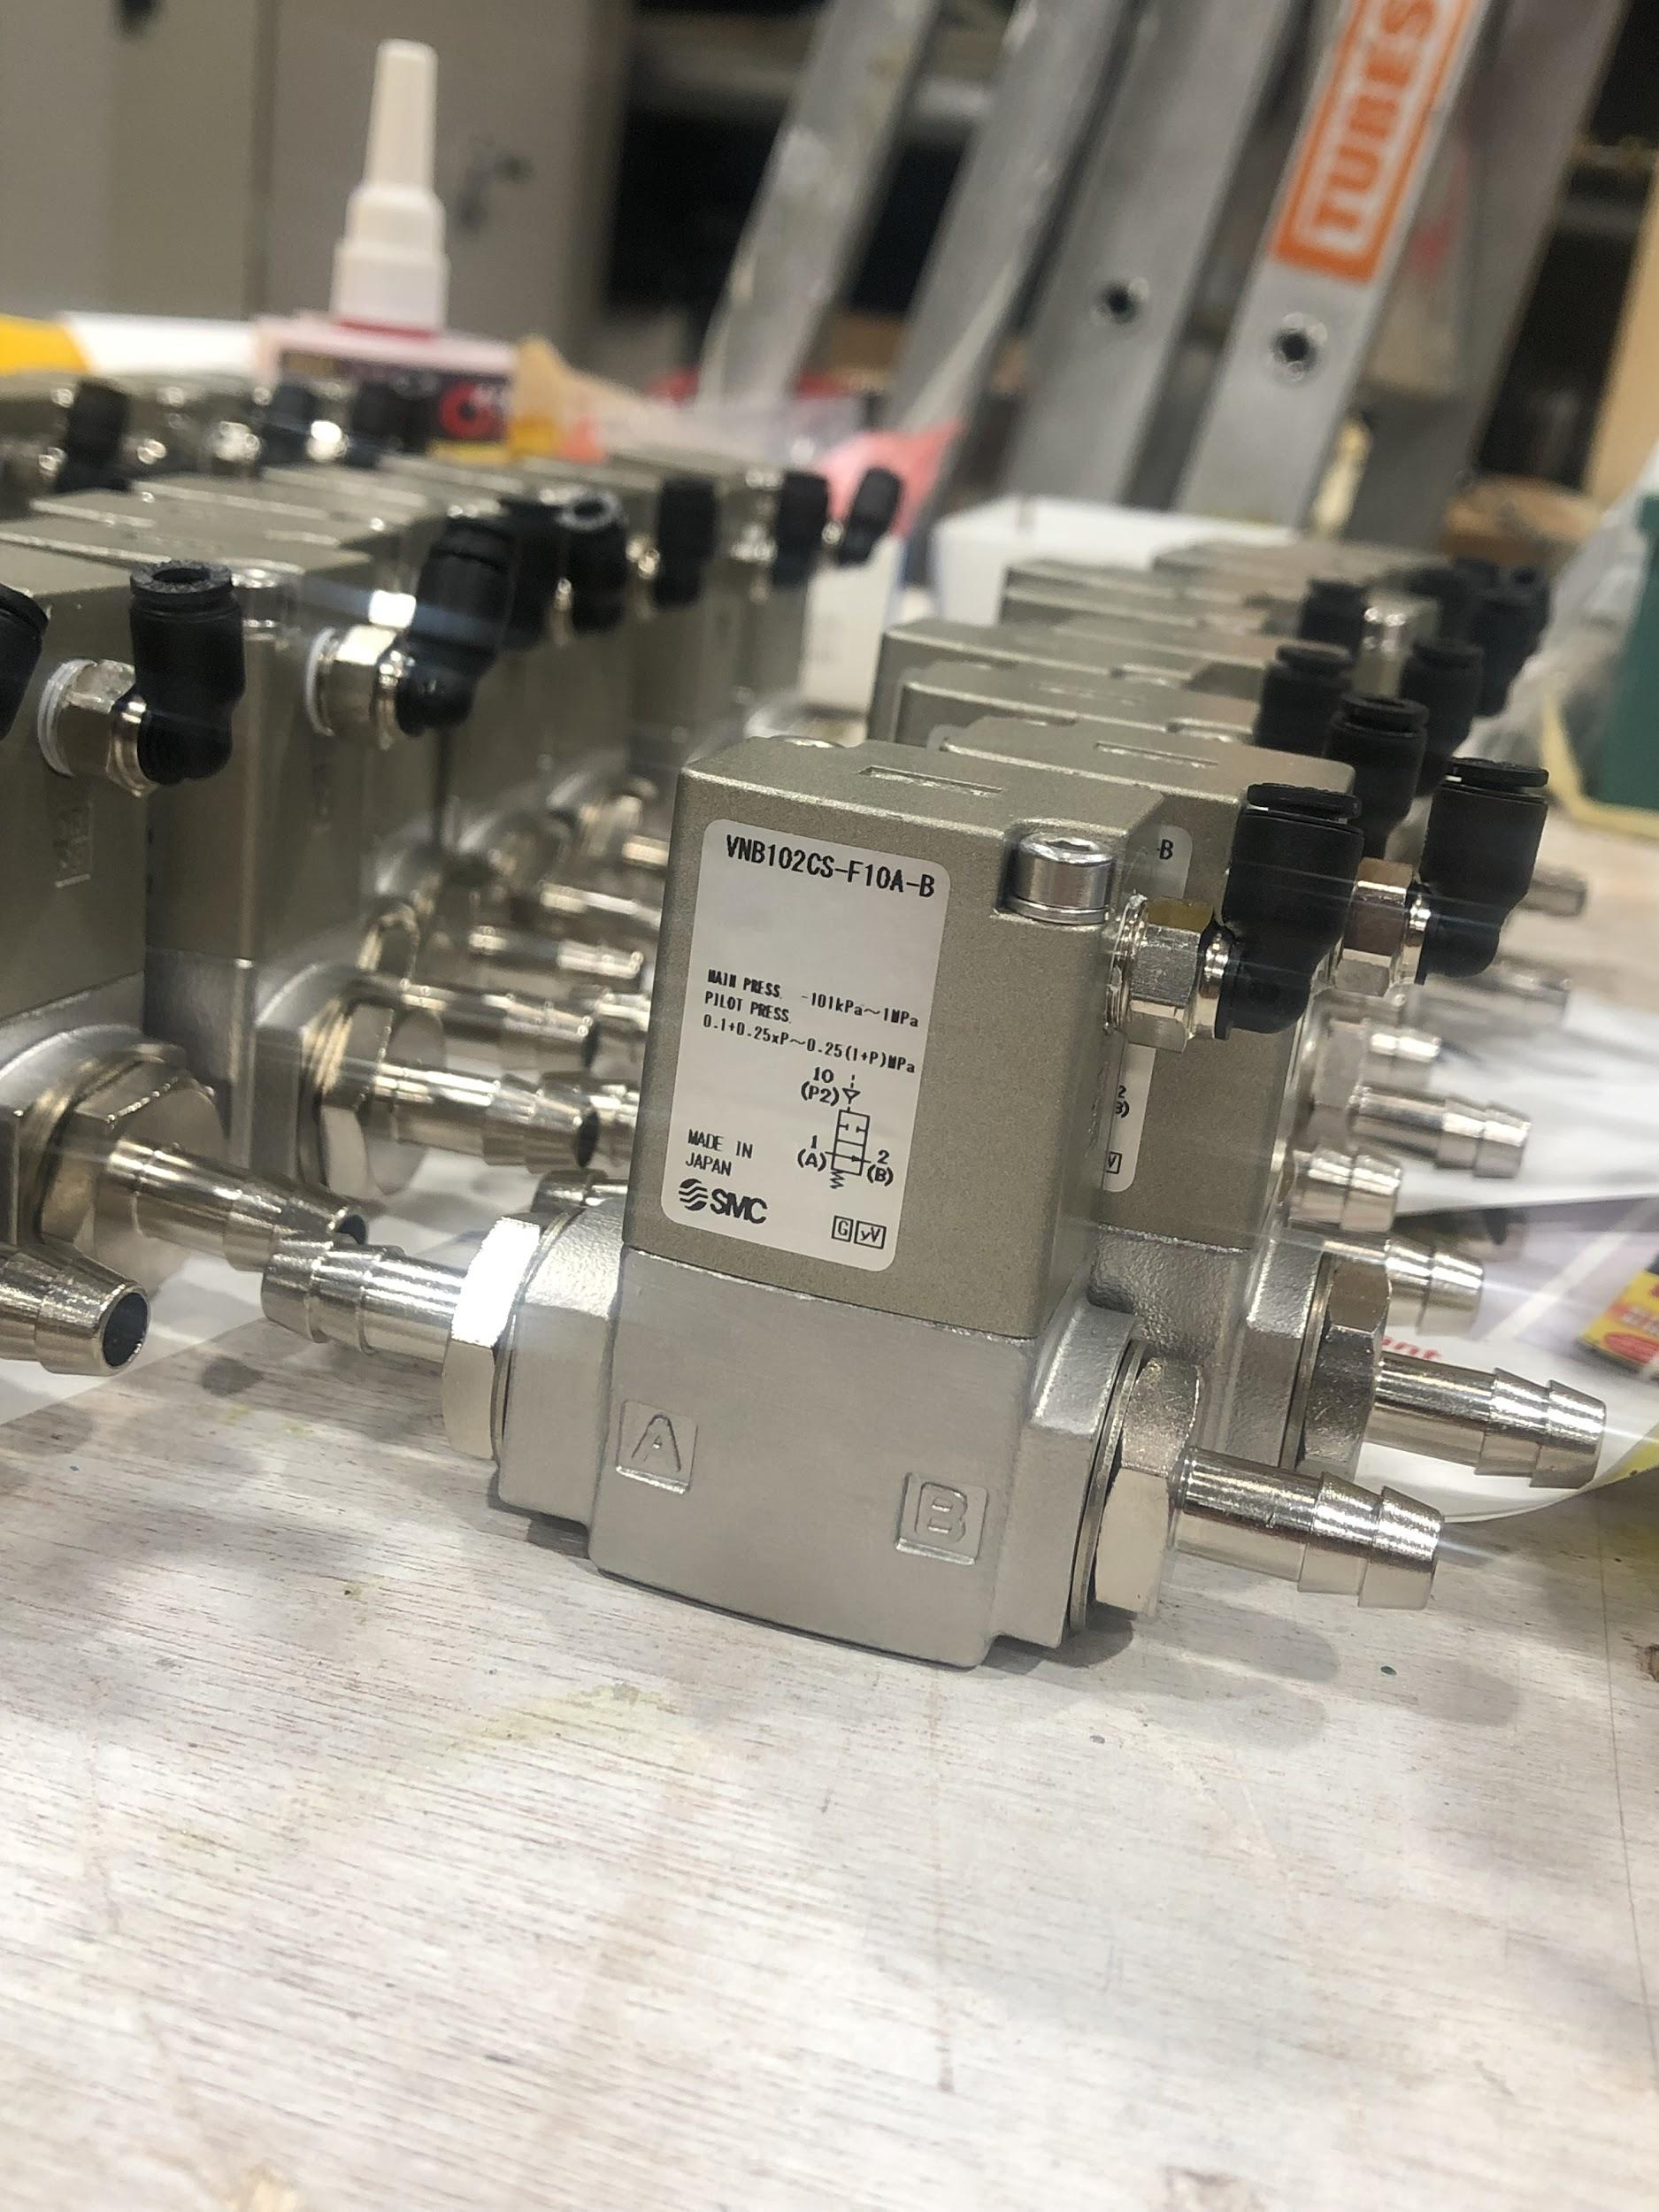
Building and Testing Valves
Add non-magnetic and radiation-resistant screws
Insert valve nozzles
Let valves sit for >24 hours so that seal adhesive has time to dry
Test seal quality under pressure. If valves pass, they are ready to be installed
We have made ~125 and 0 have failed

Slide 7
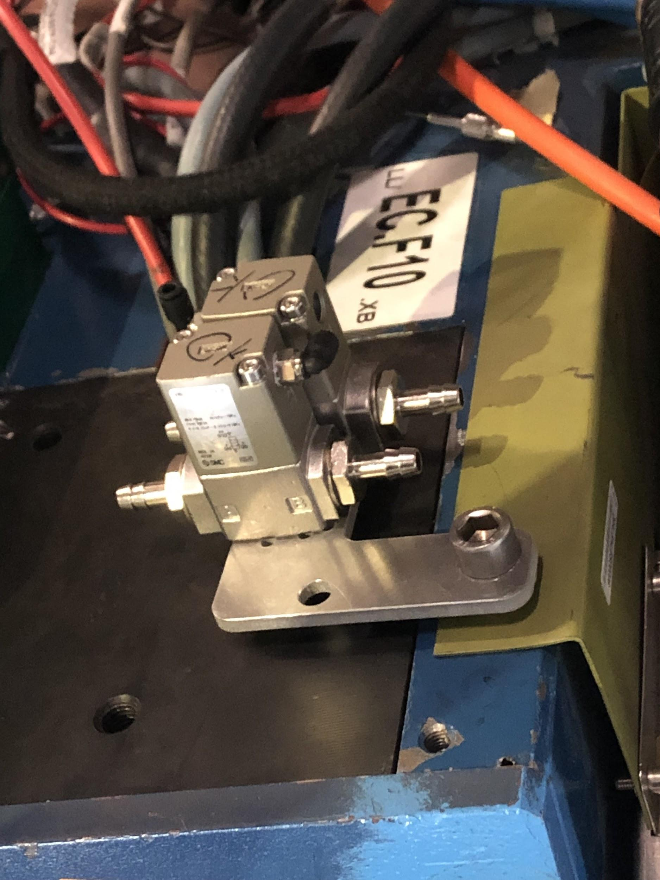
Mounting Valves
Have a variety of different shapes of mounting plates
Orientation is critical!
Hoses must be able to reach valve nozzles without bending too much
Valve nozzles must not be too close to walls/other wires
Ideally plates should be secured with two bolts, but sometimes that is not possible

Slide 8
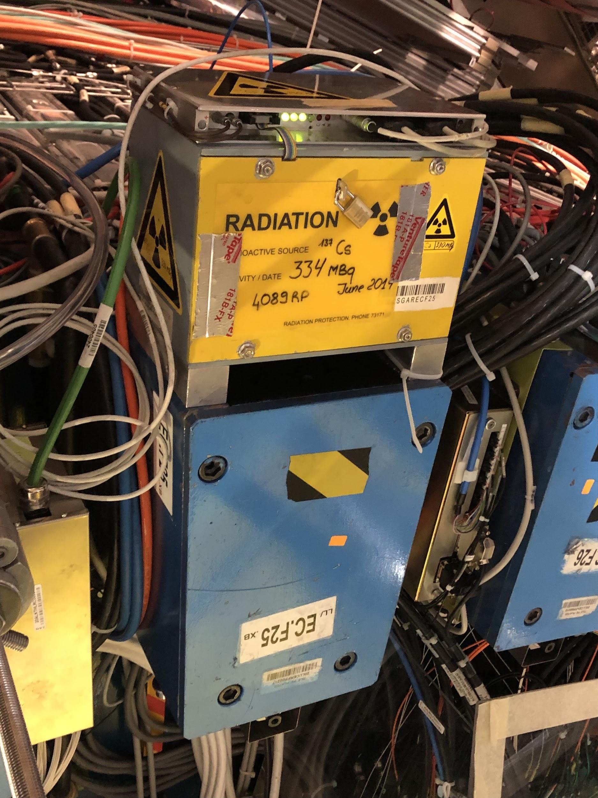
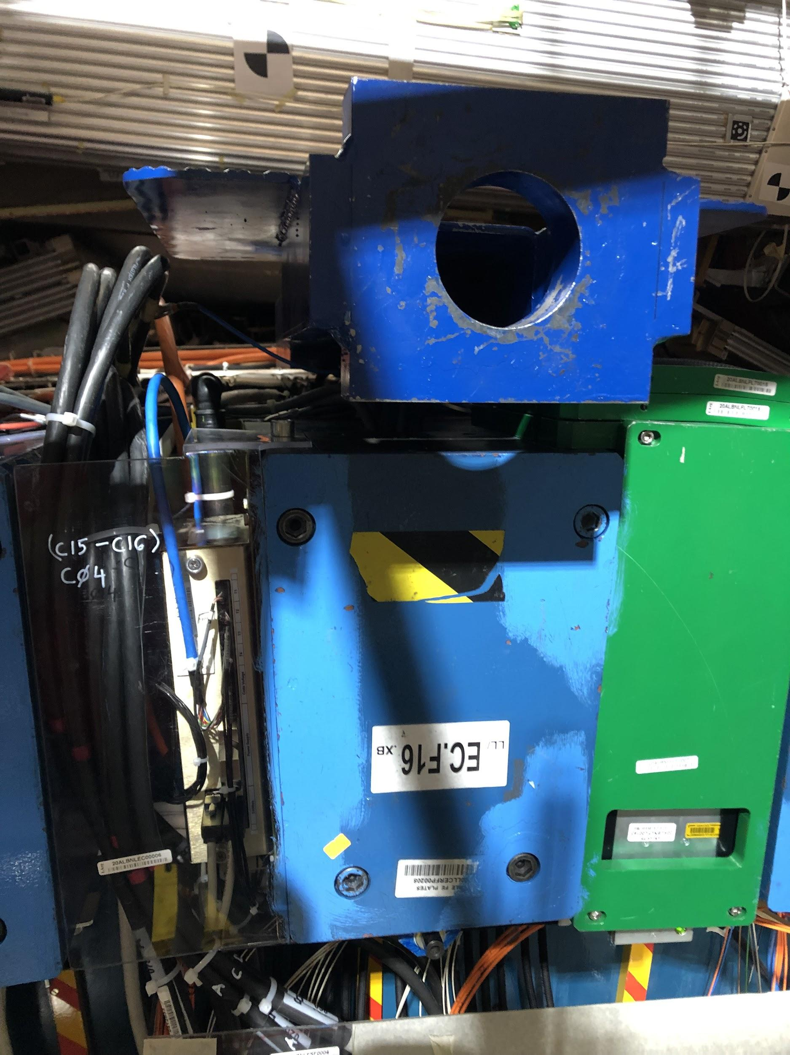
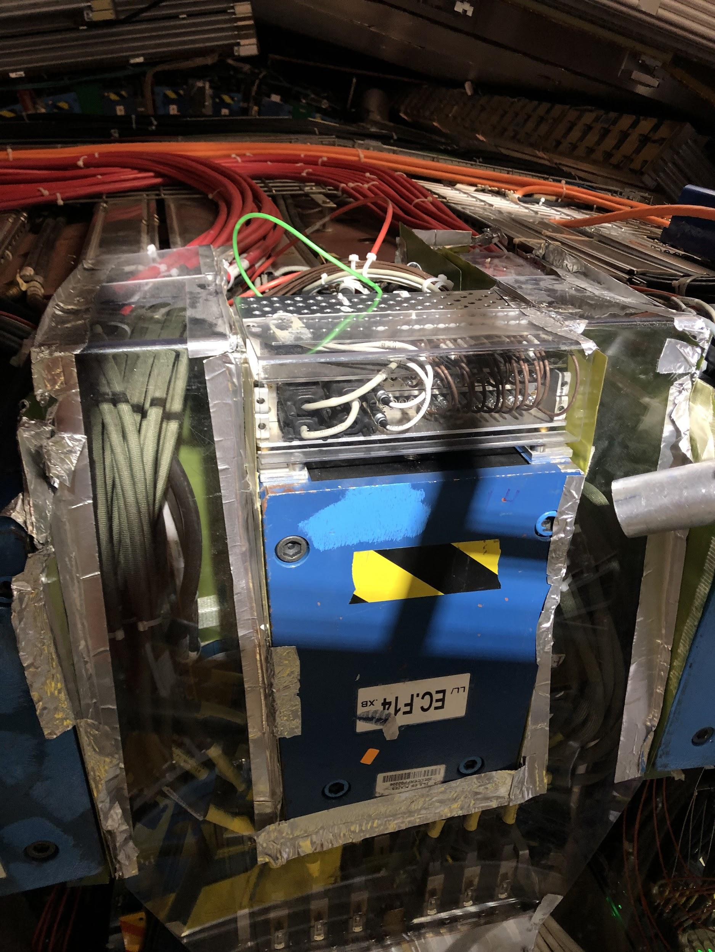
Difficulties with Mounting
Cesium box blocks most of the space for mounting
No space on top due to wires, can’t access the sides either
Beam blocks valves from fitting underneath

Slide 9
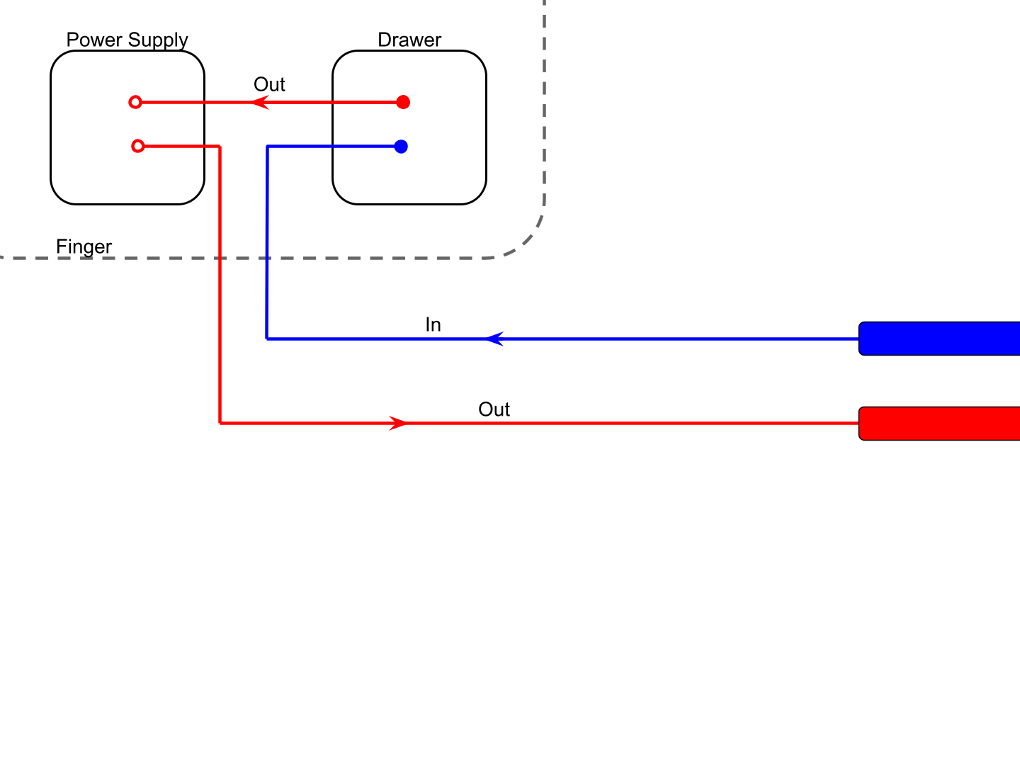
Initial Hose Connection
Pipes

Slide 10
Old Method
Disconnect hose from inside drawer, cut+insert new longer hoses so that they reach the valves
Cut pre-existing hoses here to fit into the other side of the valves

Slide 11
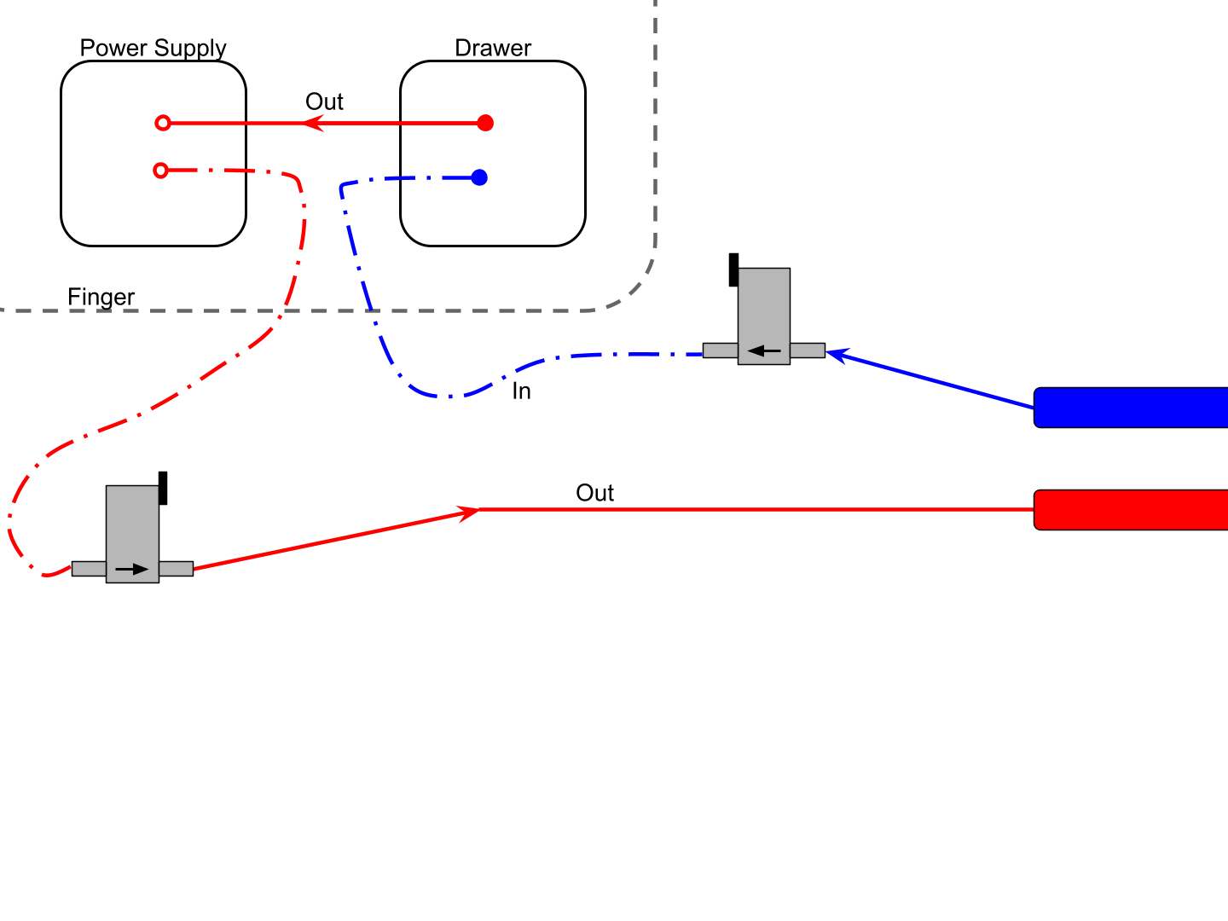
Old Method
Very time intensive, we have to open drawers and also add male/female connectors on the new hoses we cut (something we did not have a lot of).

Slide 12
New Method
Disconnect hoses here -- don’t touch the hoses inside the drawer. Cut new hoses and fit their end to the in/out pipes.

Slide 13
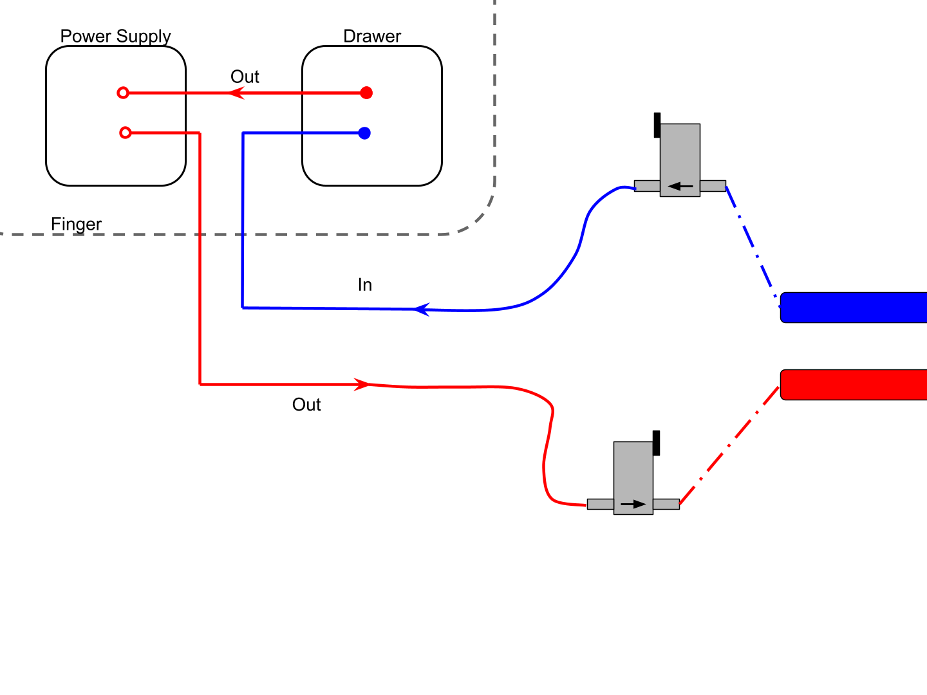
New Method
This is a much quicker method as we don’t have to open the drawers. However, sometimes it can be awkward to reach the in/out pipes as often they are far away from the scaffolding.

Slide 14
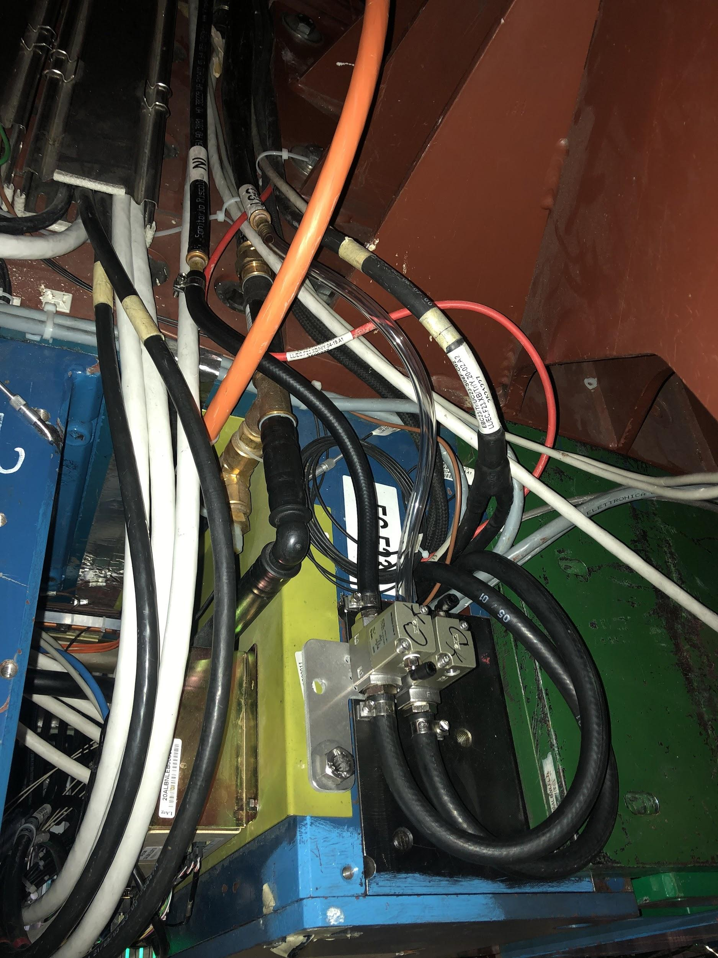
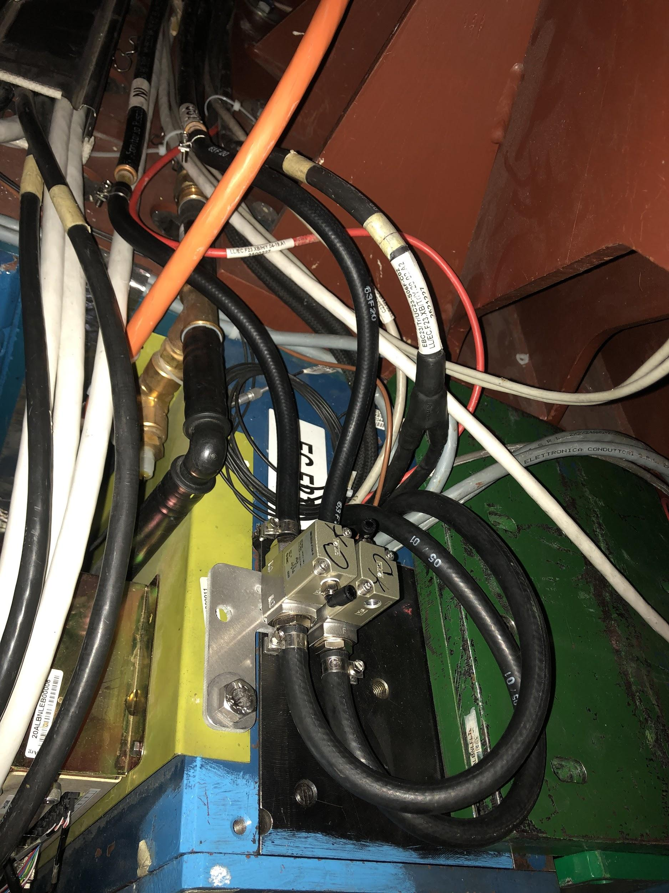
Examples
Removed clear hoses on “out” line

Slide 15
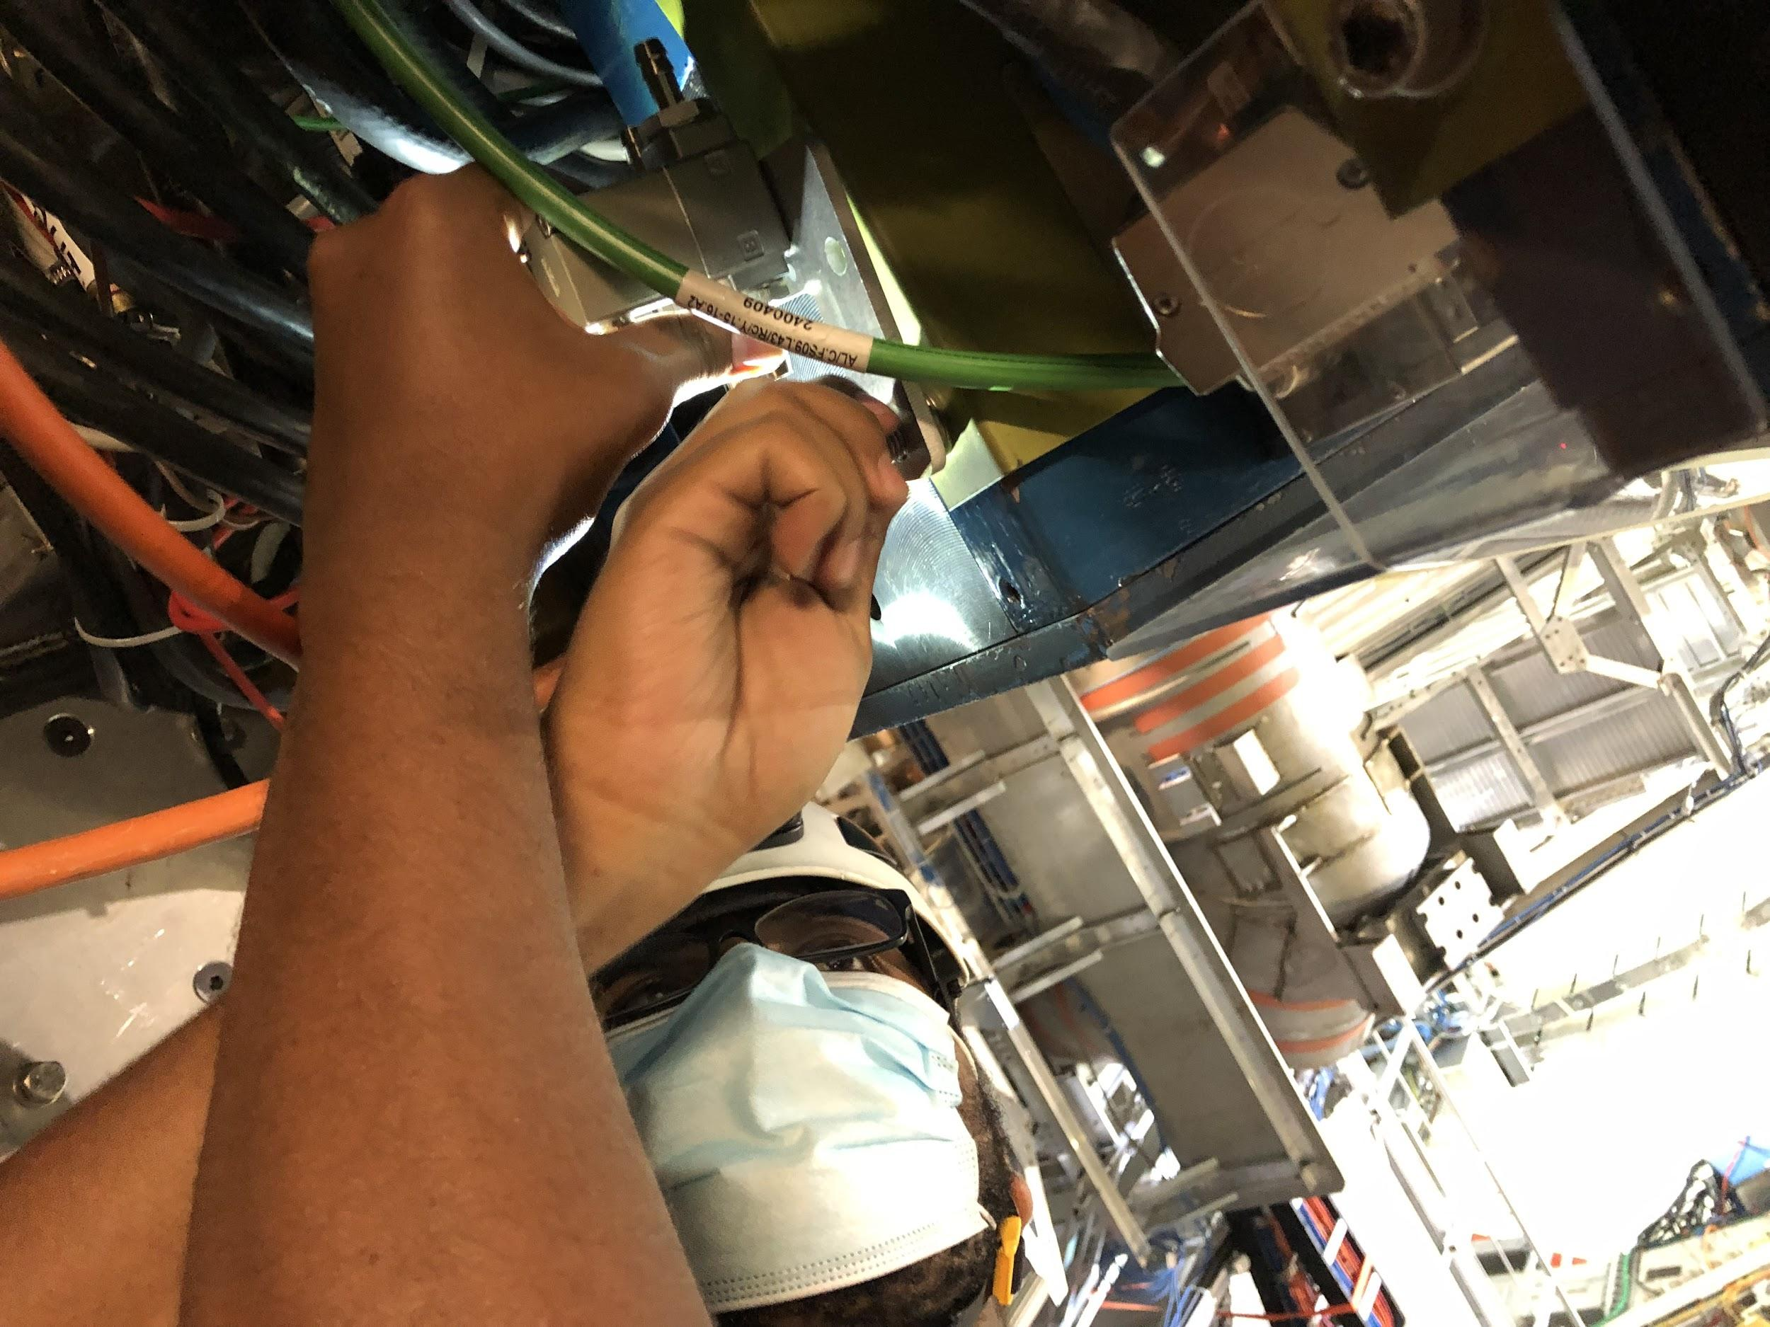
Current Status
Mounted and pneumatic pipes connected on all LBA and LBC modules
Commissioning of valves started yesterday. Loop 16 of LBC partition is done.
Mounted and connected valves on 59/64 of the modules on EBC
EBC 04, 08, 14, 16, and 25 were difficult to mount on and were skipped
Later:
Begin work on EBA (Nov. 8)
Continue building/testing valves so there is enough to complete EBA
Connect air hoses

Slide 16
Maintenance

Slide 17
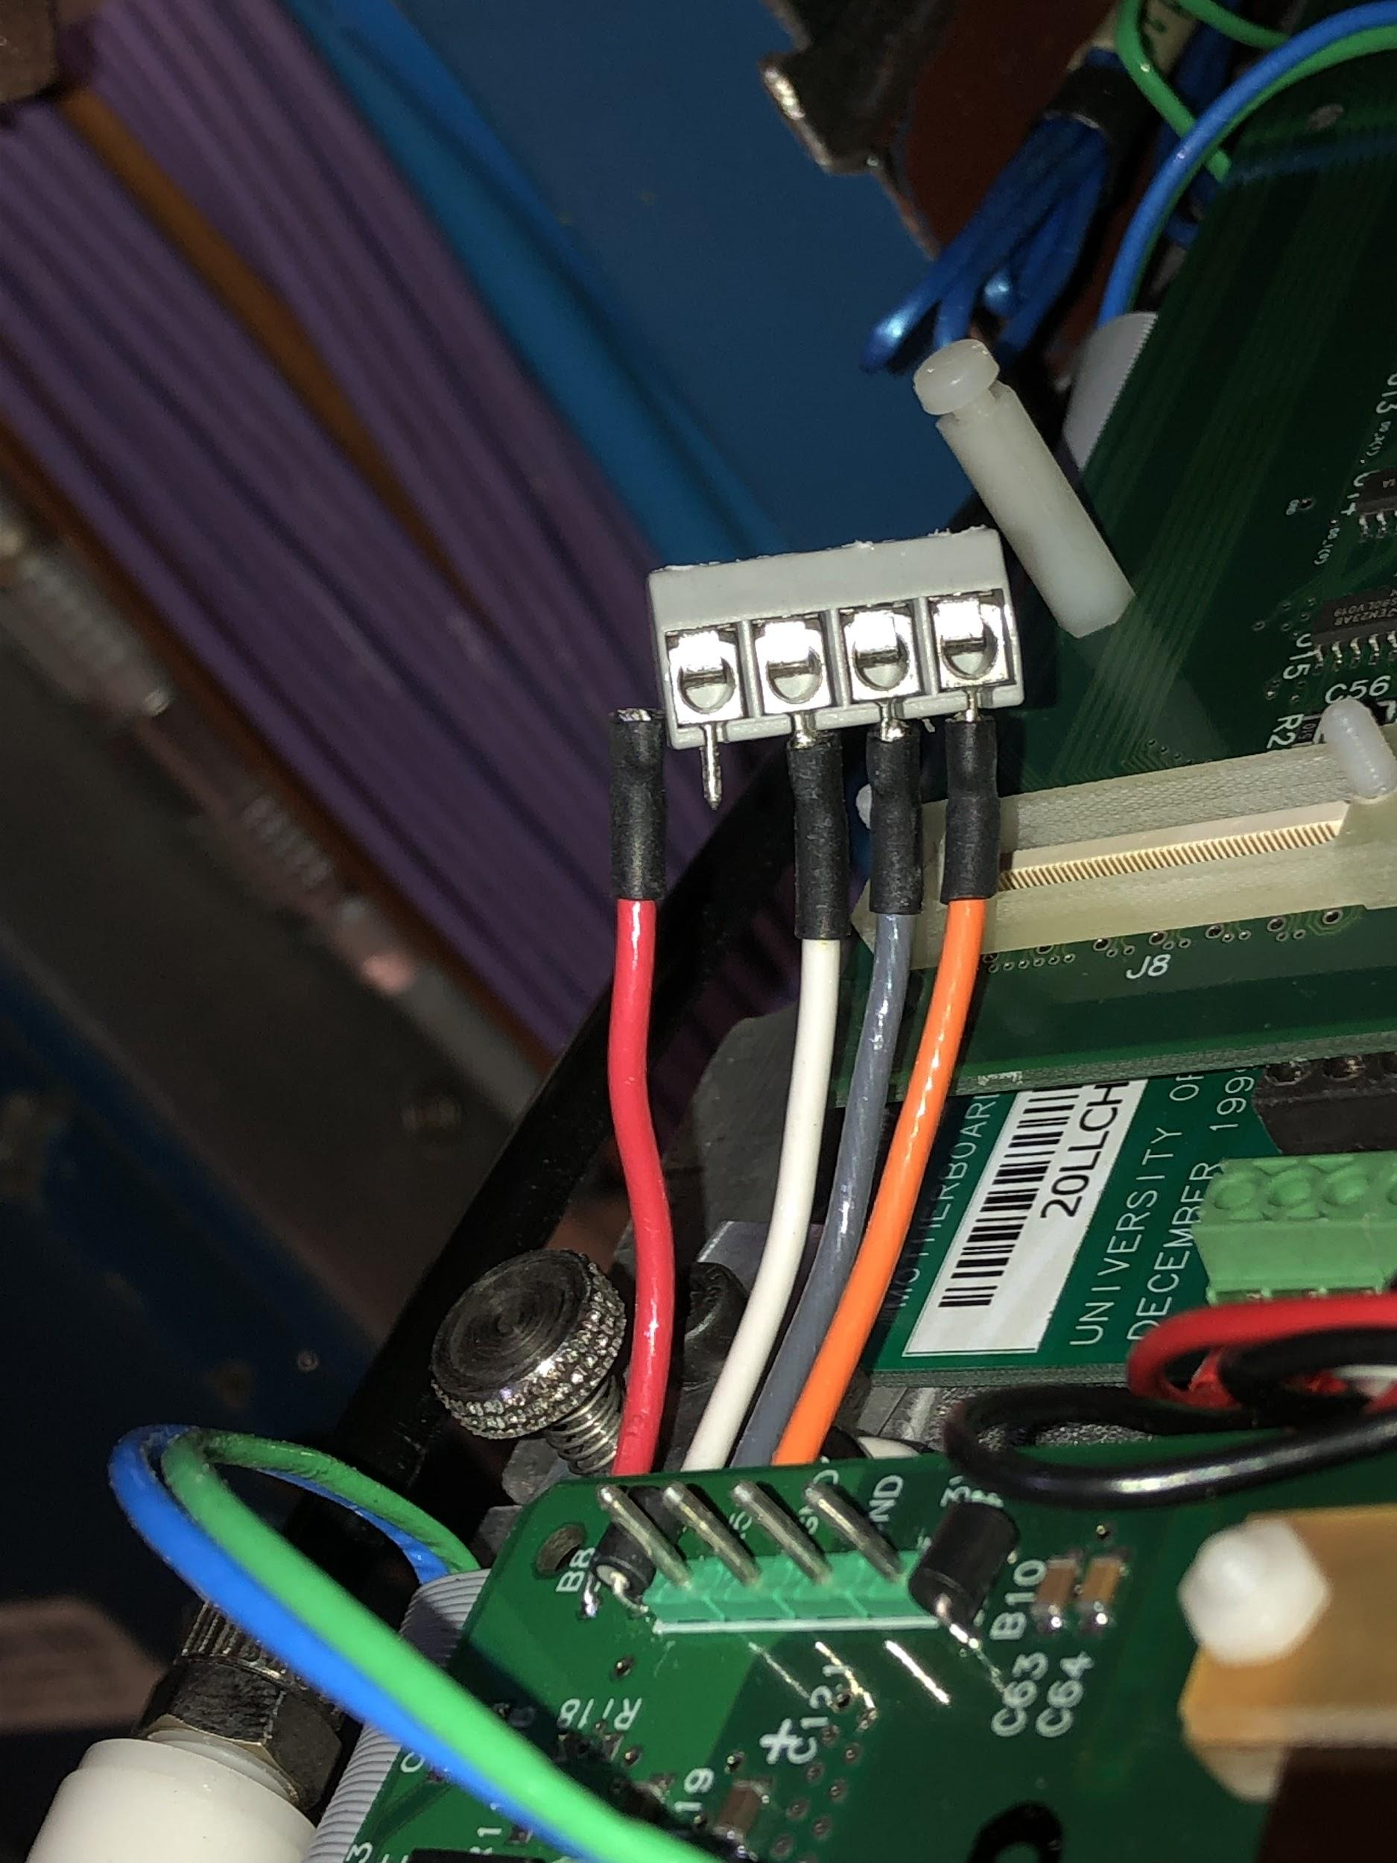
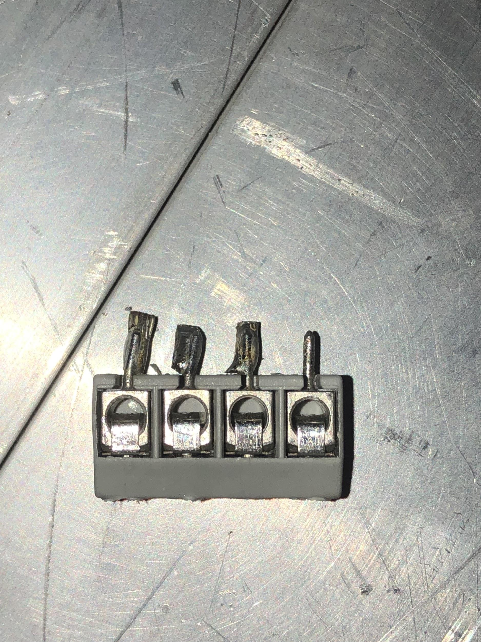
LBC 63
Problem: no data from PMT25-48
Opened Oct. 4
The 5V Digitizer wire was found unsoldered for digitizer 4 and was replaced
Drawer was closed and tested with MobiDICK, working good now

Slide 18
Other Maintenance
LBC 55 (Sept. 23): Drawer opened to fix the problem with internal odd PMTs (no HV). Internal HV-opto card was replaced.
LBA 21 (July 7): Opened to fix the Stuckbit problem with ch. 32 (PMT31) on digitizer3. Digitizer replaced.
EBA 54 (July 7): The drawer was opened from both sides to fix the problem with PMT7 (bad for all calibrations). Digitizer7 was replaced.
EBA 51 (June 29): Opened to fix the problem with the first PMT (LG signal low). 3in1 card was replaced and problem was fixed.
LBC 06 (April 26): Opened because power consumption for 5Dig is very low. One wire was not well inserted, fixed.
LBC 10 (March 10): Opened, on PMT48 the HV noise killer was found damaged. Replaced and fixed.
EBC 52 (Feb. 26): Drawer opened to fix problem with HV instability. Internal HV bus-board and Digitizer2 were replaced.

